Slide 1
Work Done Since Last Review
Worked on ARX modeling of ECG signals
Coefficients were obtained which will be form as additional features for the classifier
Interfaced sensor with Raspberry-pi to obtain CSV file at correct sampling rate

Slide 2


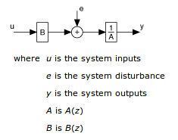

MODELING OF SIGNALS
AR Model Structure:
ARX Model Structure:

Slide 3
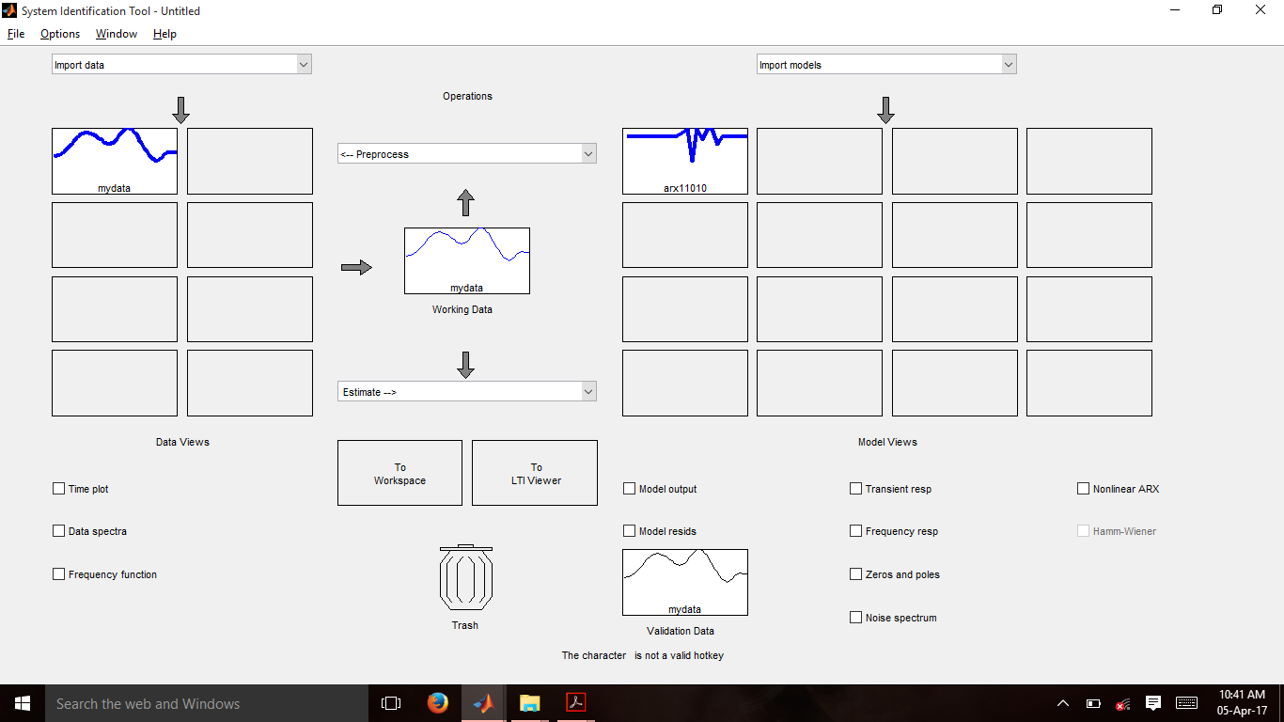
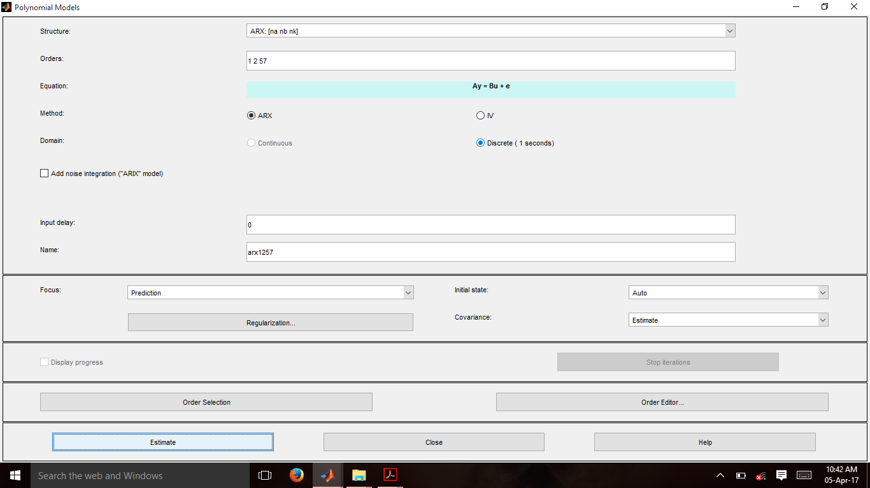
Work Done
System Identification toolbox

Slide 4
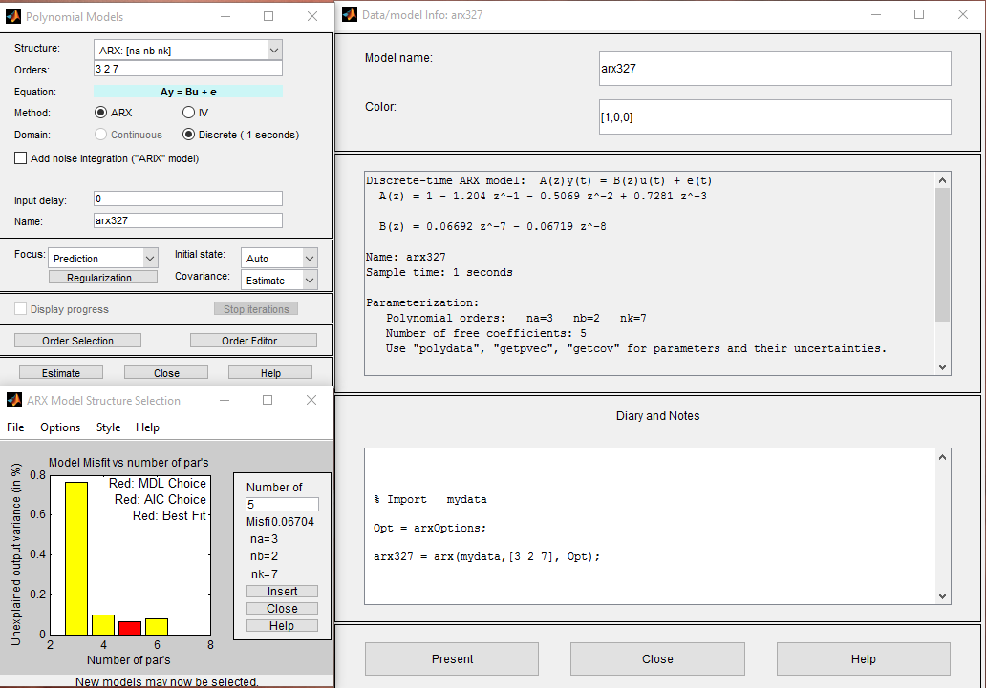
Work Done(contd.)

Slide 5
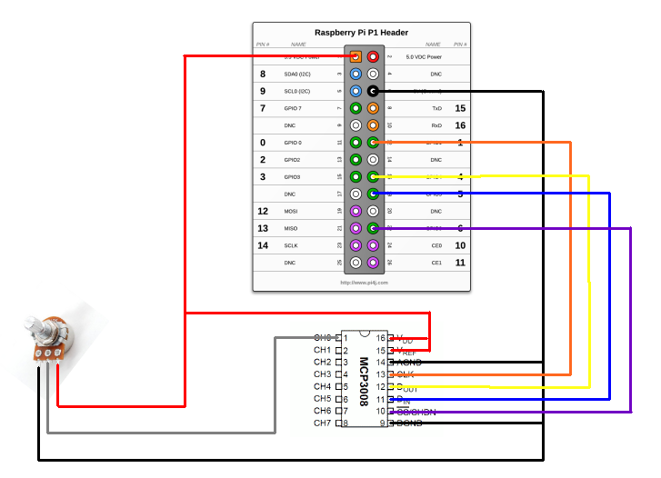
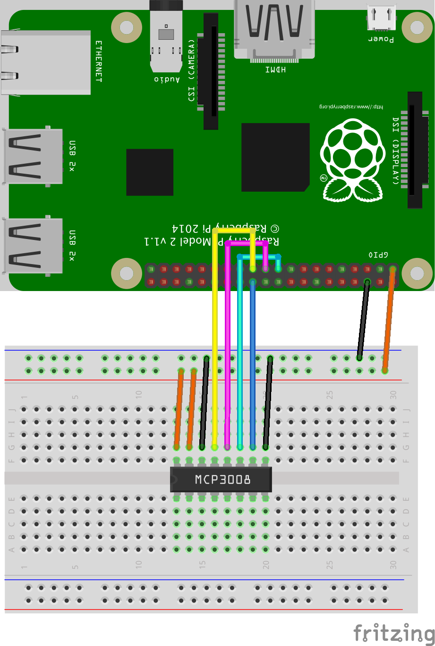
Interfacing Sensor to Rpi
Circuit Diagram :-

Slide 6
Interfacing Sensor to Rpi (Contd.)
CODE AND THE OUTPUT SCREENSHOT TO BE PUT HERE

Slide 7
Targets for Next Review
Remove dependence on System Identification toolbox and convert everything to command line codes
ARX modeling coefficients to be calculated for all samples and consolidated into a single csv file, one for alcoholics and other for non-alcoholics
Port the frequency domain feature extraction MATLAB code to Python
Integrate hardware and all python codes on the Raspberry Pi to make a complete system

Slide 8
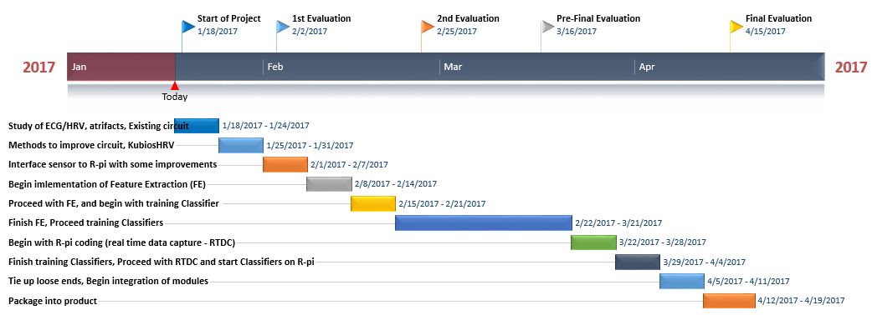
TIMELINE
On schedule as per expected timeline

